Slide 1


Styling the Web: An Introduction to CSS
Discover the power of CSS to transform your web designs. This presentation will guide you through the essentials of Cascading Style Sheets, making your web pages visually appealing and engaging. Let's make your HTML shine!
by Bukunmi Adigun

Slide 2

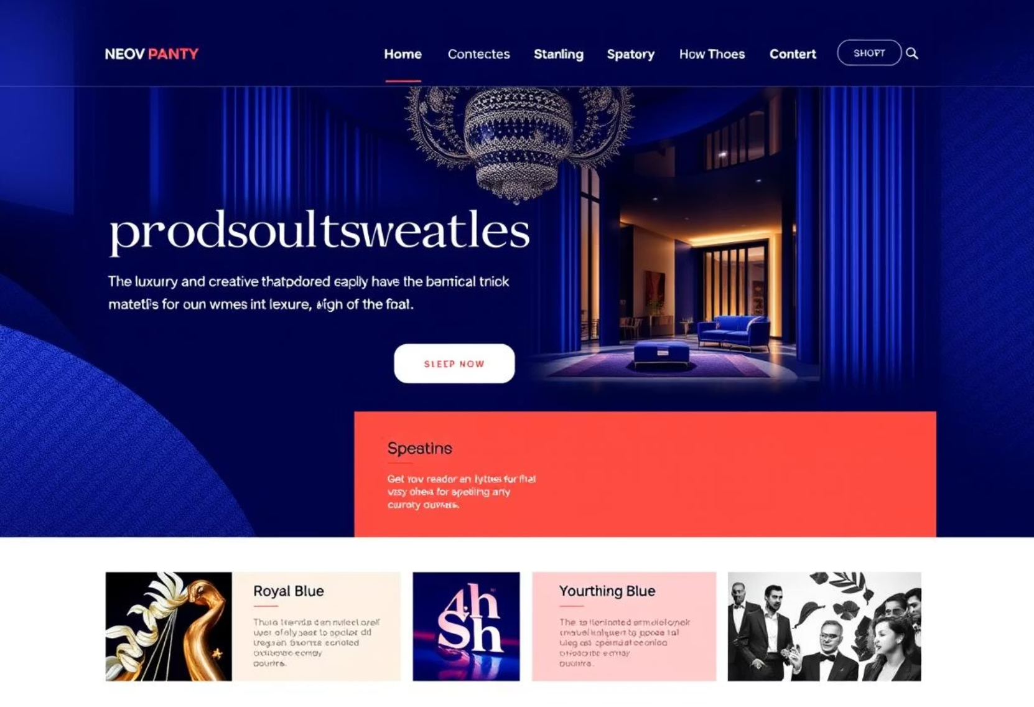
What is CSS? Giving Your HTML a Makeover
Before CSS
After CSS
HTML provides structure, but it lacks visual appeal. Without CSS, web pages appear as plain, unformatted text. They are functional, but visually unengaging.
CSS is the language of web styling. It allows you to add colours, fonts, layouts, and responsiveness. CSS transforms plain HTML into stunning visual experiences.

Slide 3

The Art of Selection: Targeting Elements with Precision
CSS selectors are crucial for applying styles to specific HTML elements. They allow you to target elements by tag name, class, ID, or attributes. Mastering selectors ensures precise styling control.
Element Selectors
Class Selectors
Target elements by their HTML tag, such as P or H1.
Apply styles to multiple elements using a custom class name.
ID Selectors
Target a unique element on the page with a specific ID.

Slide 4
Core Properties & Values: Bringing Style to Life
CSS properties define what you want to style, and values define how. Common properties include colour, font-size, and background. These combinations bring your designs to life.
Property
Description
Example
color
Sets text colour.
color: blue;
font-family
Changes text font.
font-family: Arial;
background-color
Sets element background.
background-color: #f0f0f0;
margin
Adds outer spacing.
margin: 10px;

Slide 5
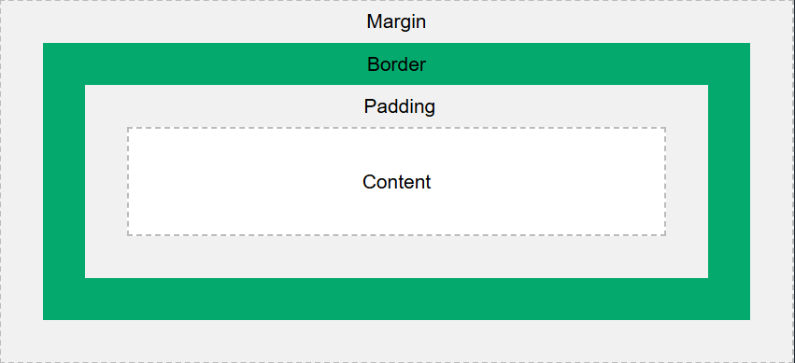
Understanding the Box Model: Every Element is a Box!
Every HTML element is essentially a box. The CSS Box Model describes how elements are rendered, including their content, padding, border, and margin. Understanding this model is fundamental for precise layout control.
Content
Padding
The actual text or images within the element.
Space between content and border.
Margin
Border
Space outside the border, separating elements.
A line around padding and content.

Slide 6



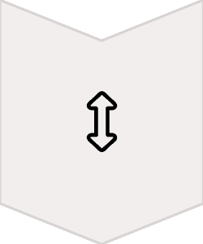
Layout Essentials: Flexbox for Flexible Designs
Flexbox is a powerful CSS layout module. It provides an efficient way to arrange, align, and distribute space among items in a container. It's essential for creating flexible and responsive designs across devices.
Flex Container
The parent element that holds flex items.
Flex Items
The children elements within the flex container.
Main Axis
Primary direction for item placement.
Cross Axis
Perpendicular to the main axis for alignment.

Slide 7
Debugging Your Styles: Tools for Success
Debugging is an essential part of web development. Browser developer tools are invaluable for inspecting CSS, identifying issues, and testing changes in real-time. Learn to use these tools effectively.
Inspect Elements
Live Editing
Right-click on any element to inspect its HTML and applied CSS. View computed styles and inheritance.
Make temporary CSS changes directly in the browser. See results instantly without modifying source code.

Slide 8

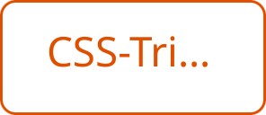
Your CSS Journey Begins: Key Takeaways & Further Resources
CSS is essential
It makes your HTML visually engaging.
Selectors are key
Target elements precisely for styling.
Box model is foundational
Understand layout and spacing.
Flexbox for responsiveness
Create adaptable layouts.
Debugging is vital
Use developer tools efficiently.

